Slide 1

Does time run slower in the far away Universe?
Type Ia supernovae tell us yes!
(but only from our perspective)
Ryan White and Tamara Davis

Slide 2
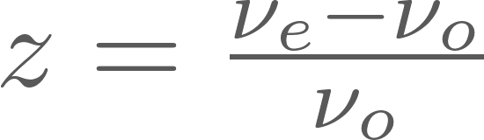
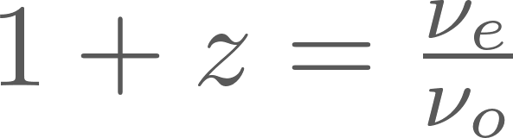
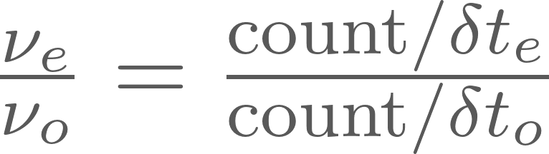
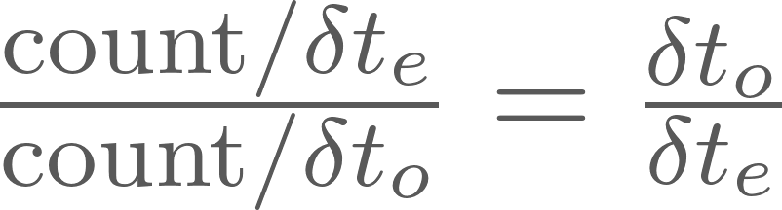
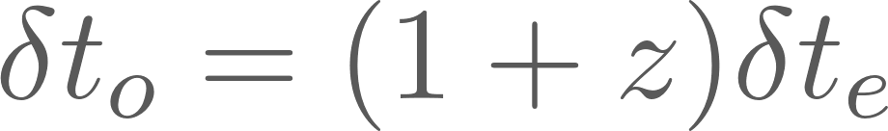
Why do we expect time dilation?

Slide 3
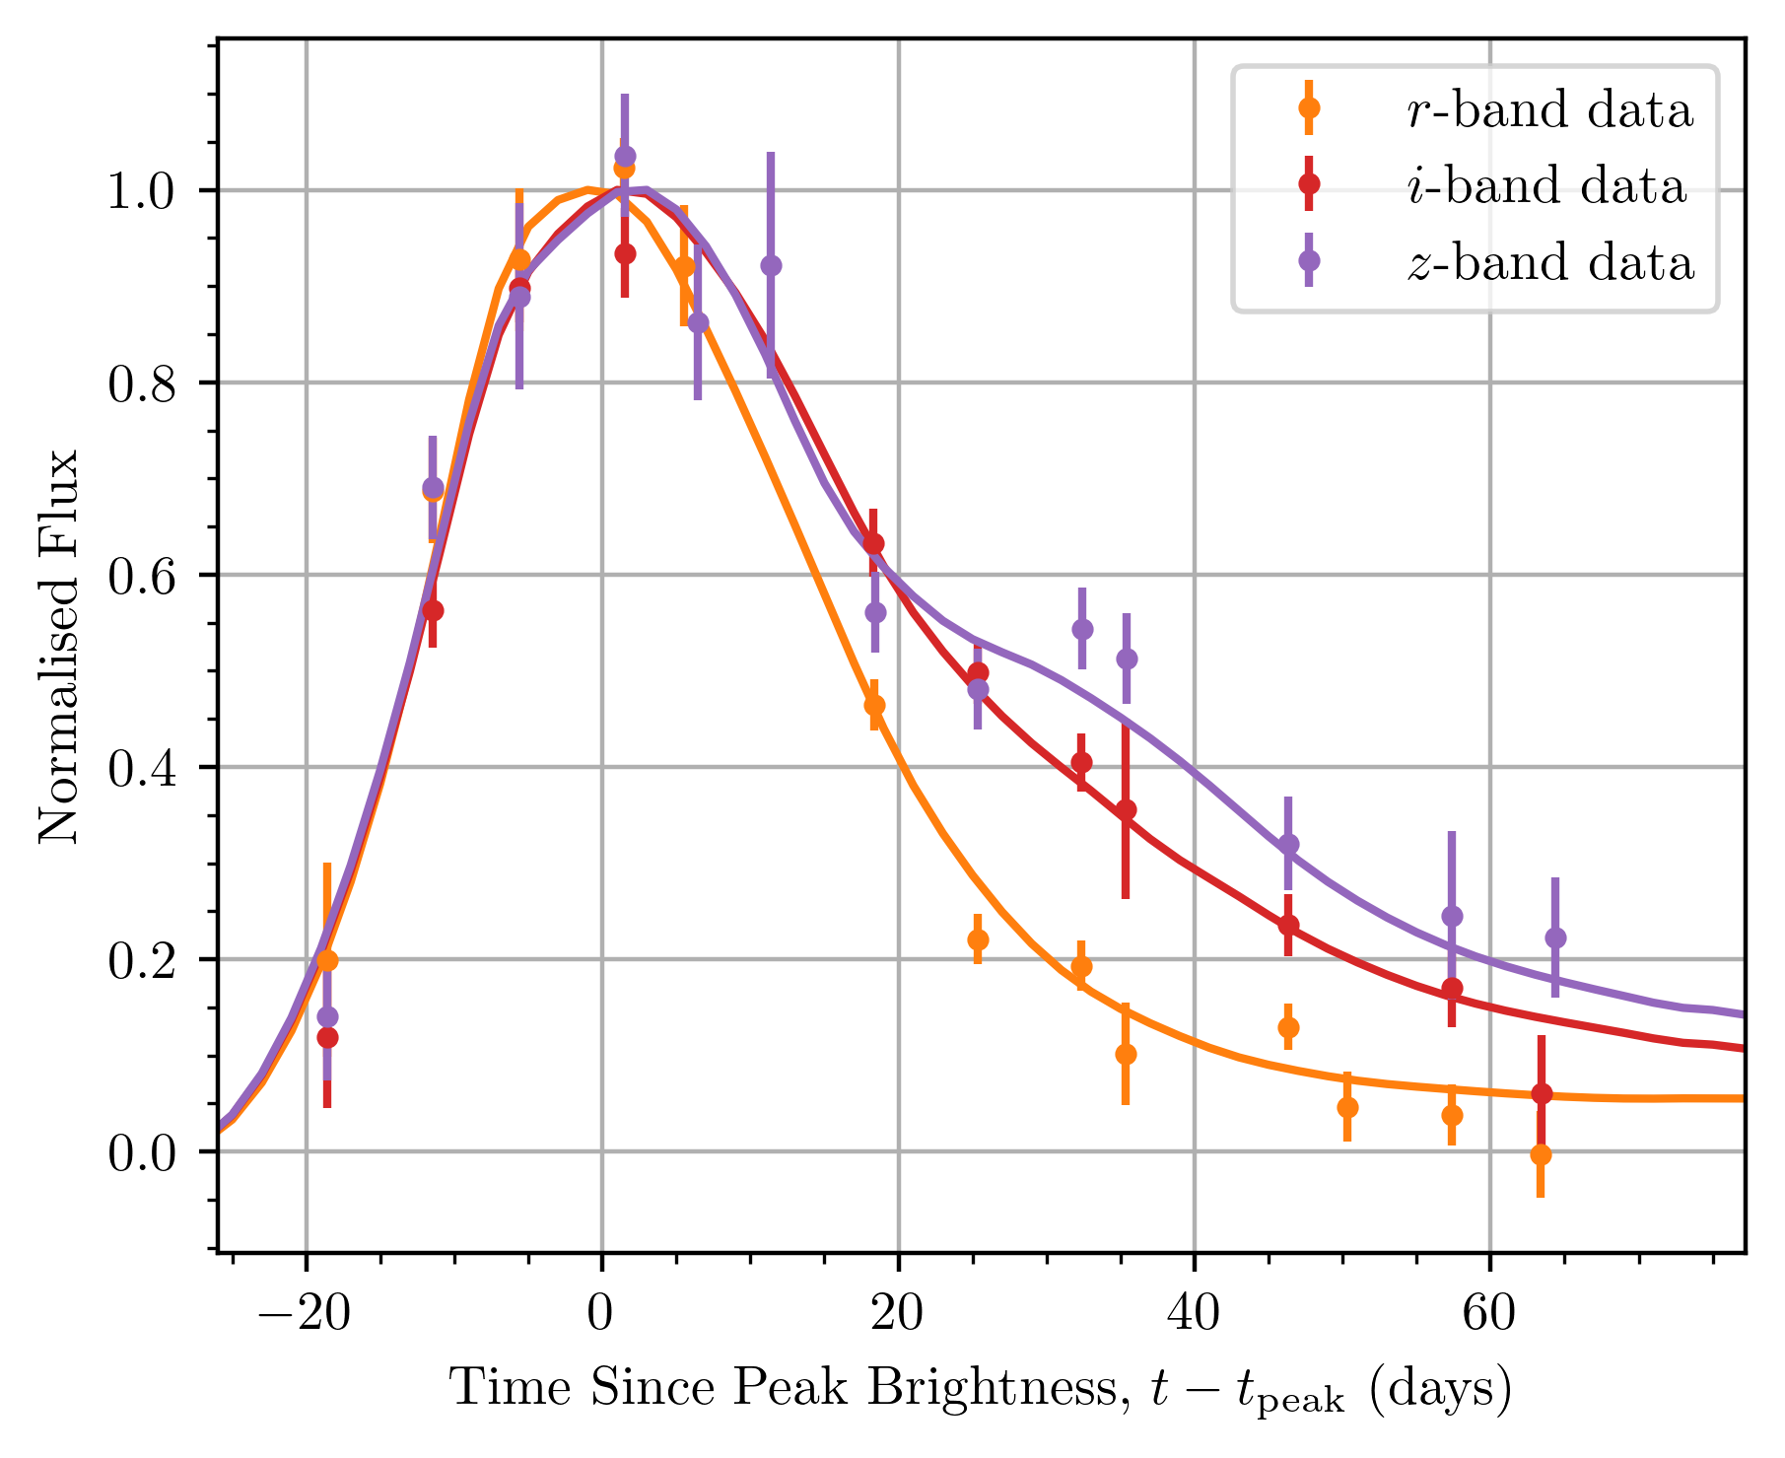
We have ~1500 SNe Ia, each looking something like this…

Slide 4
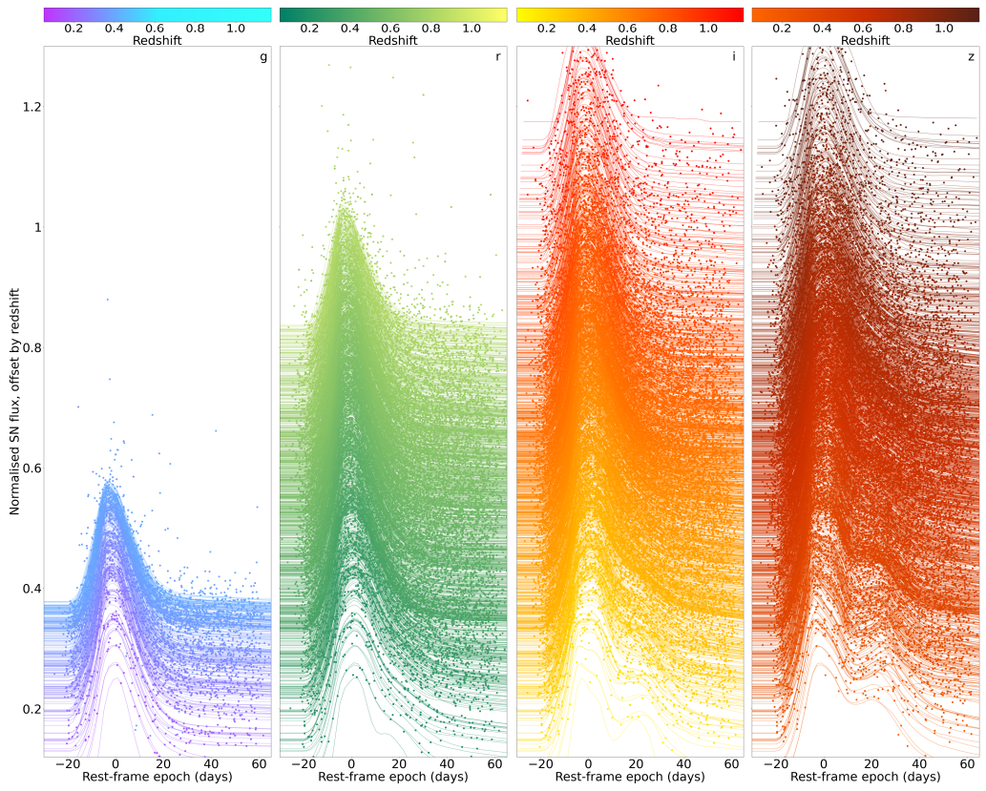
But the light curves change shape with colour…
Source: DES SN-5YR Key Paper, arXiv:2401.02929

Slide 5
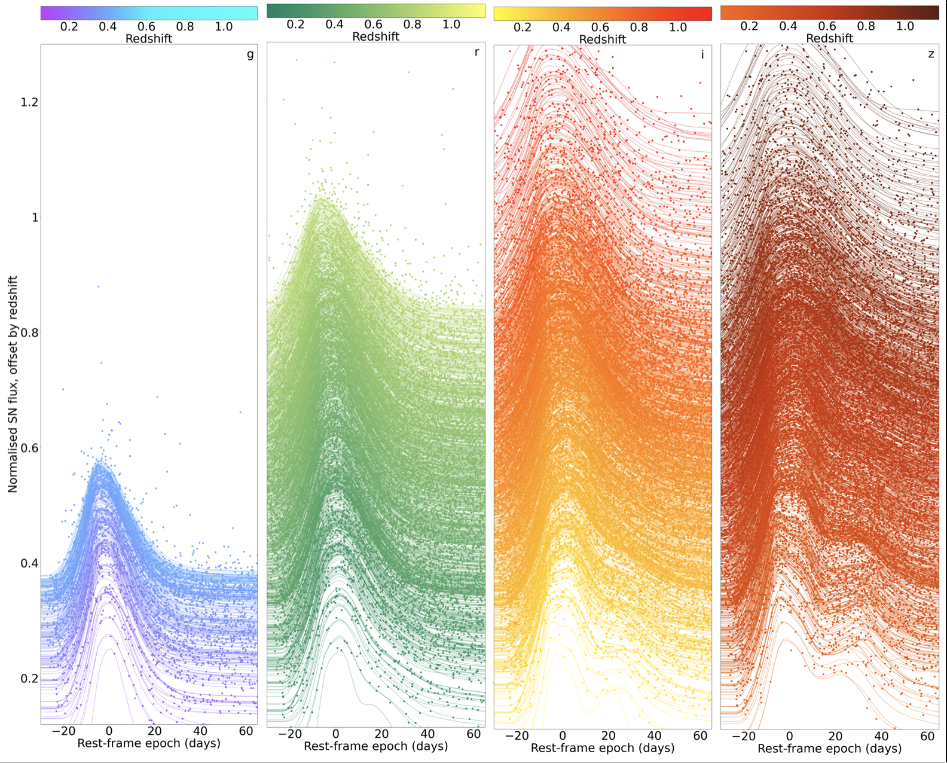
…and get wider with redshift.
Light curves without correcting for time dilation

Slide 6
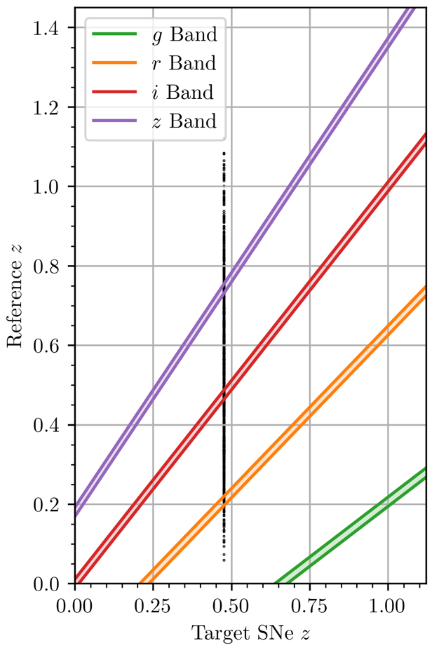
We can pick similar light curves out of different bands (colours)

Slide 7
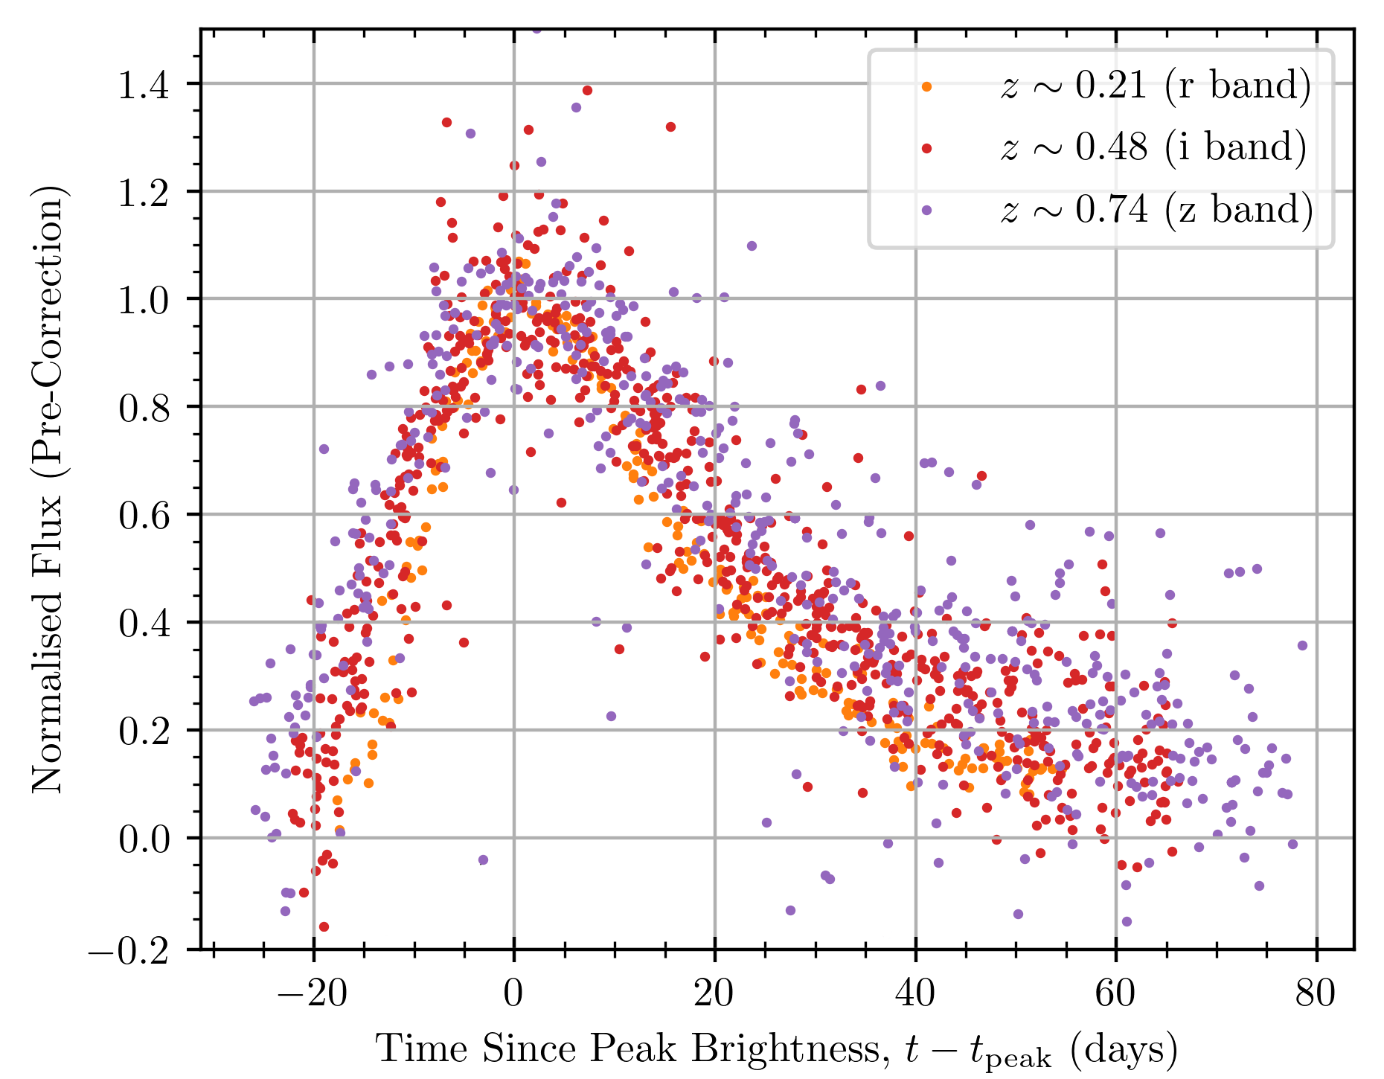
All of these light curves can be stacked and we then see a homogeneous light curve shape

Slide 8
But there’s a problem…

Slide 9
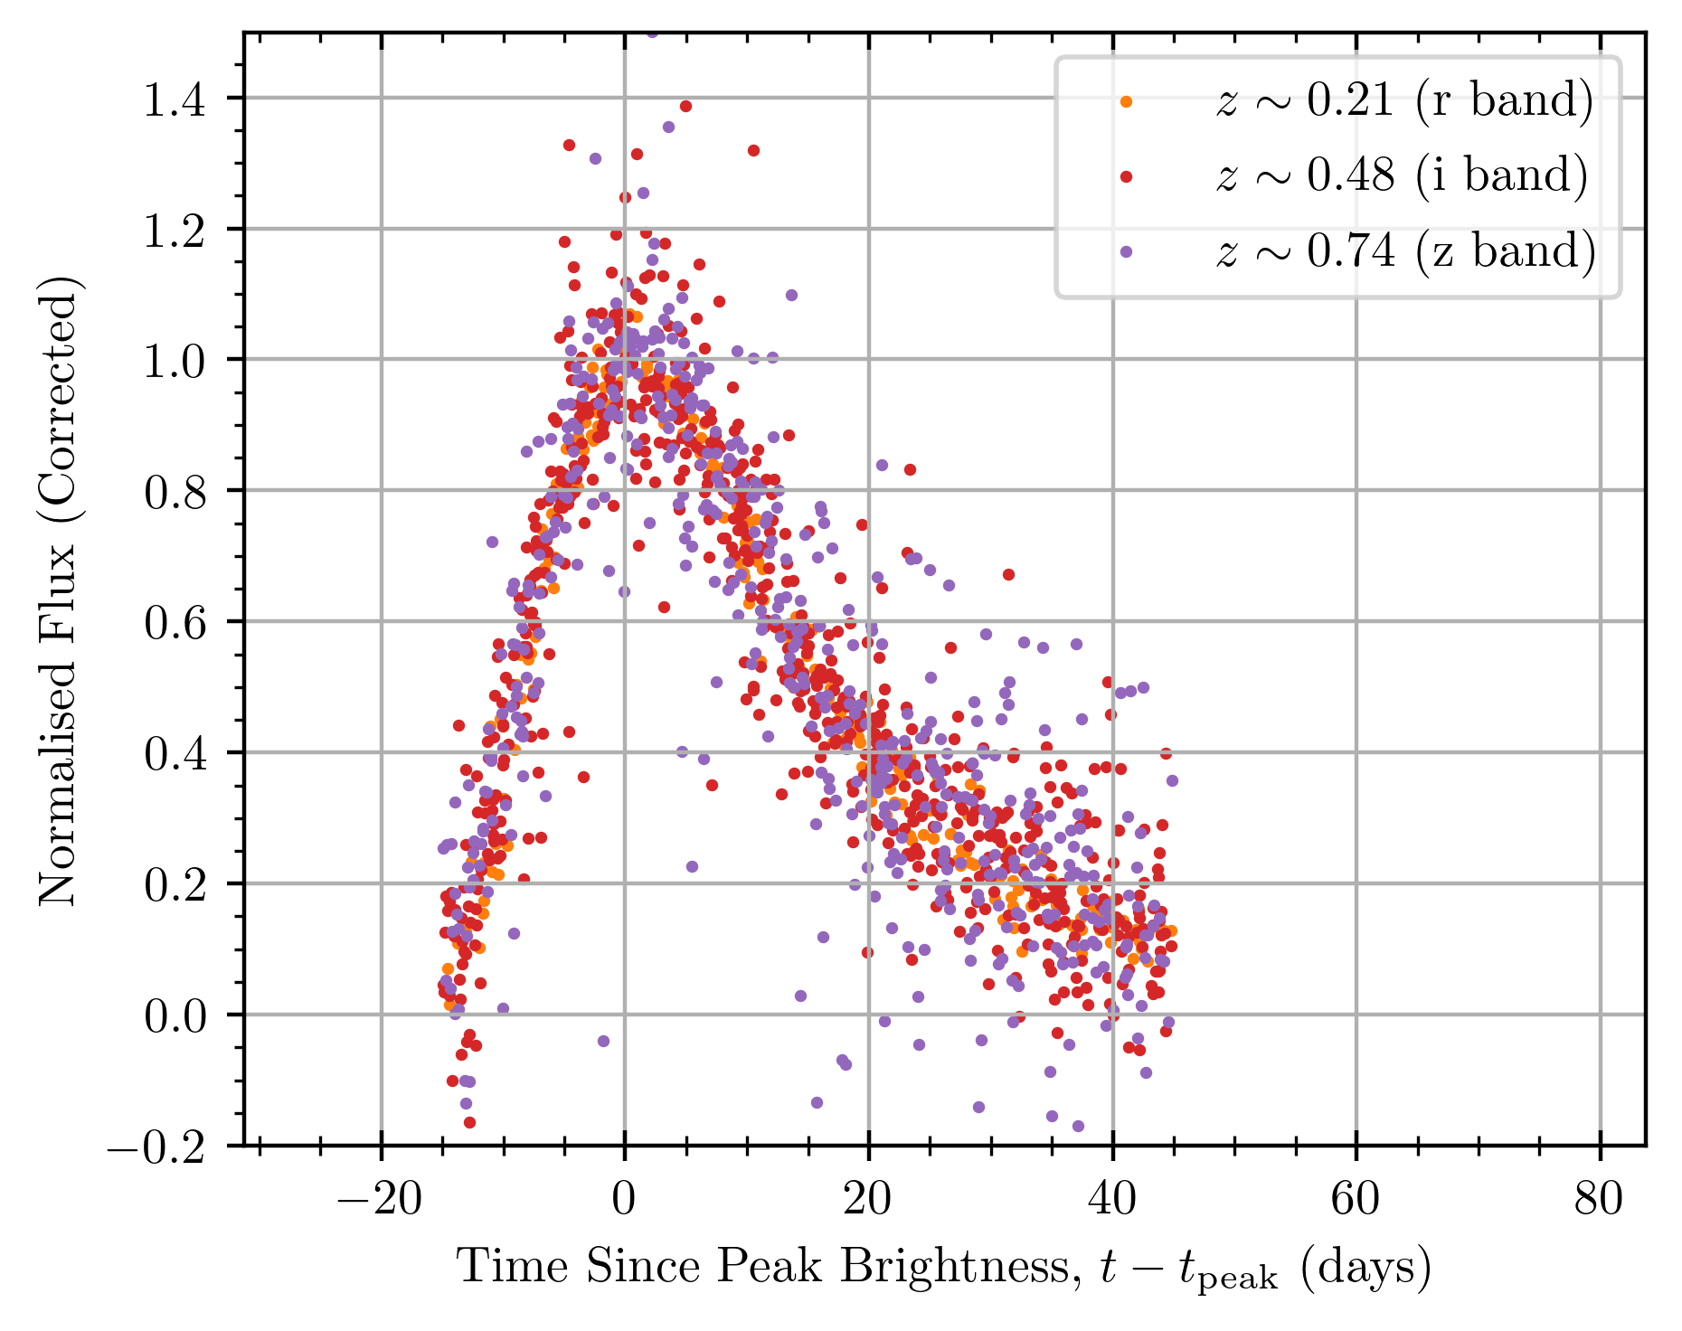
What if we scale all of the light curves in time by a function of their source redshift, (1+z)^{b}?

Slide 10
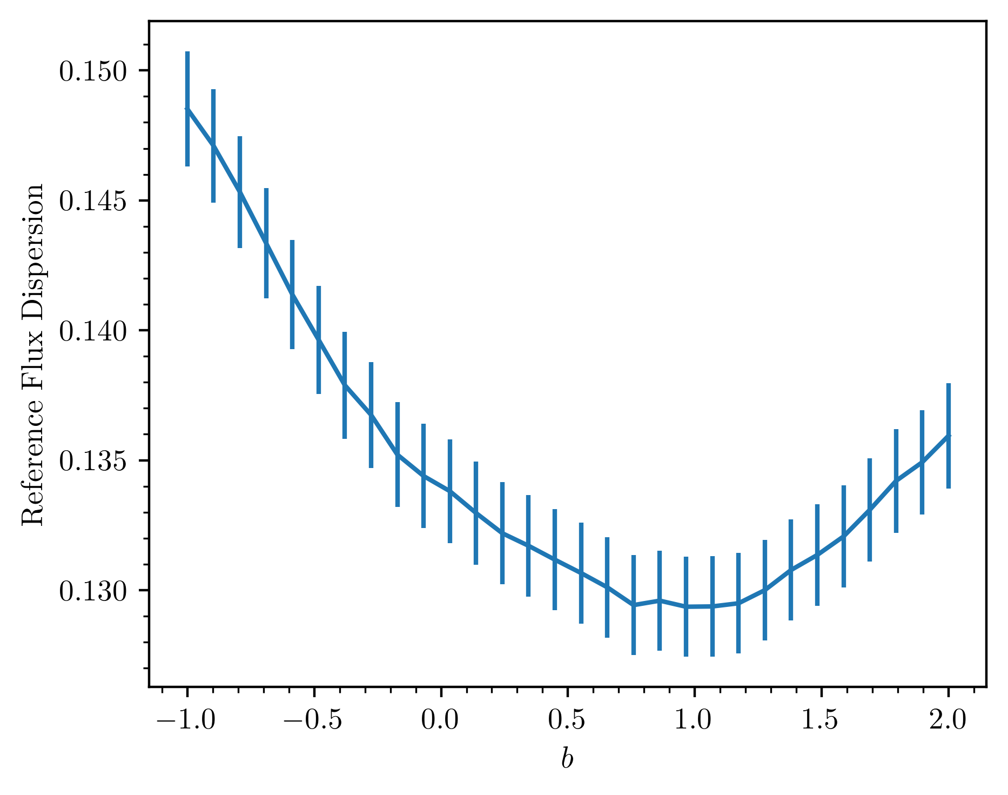
Now what if we do this for every possible reference curve in the DES dataset?

Slide 11
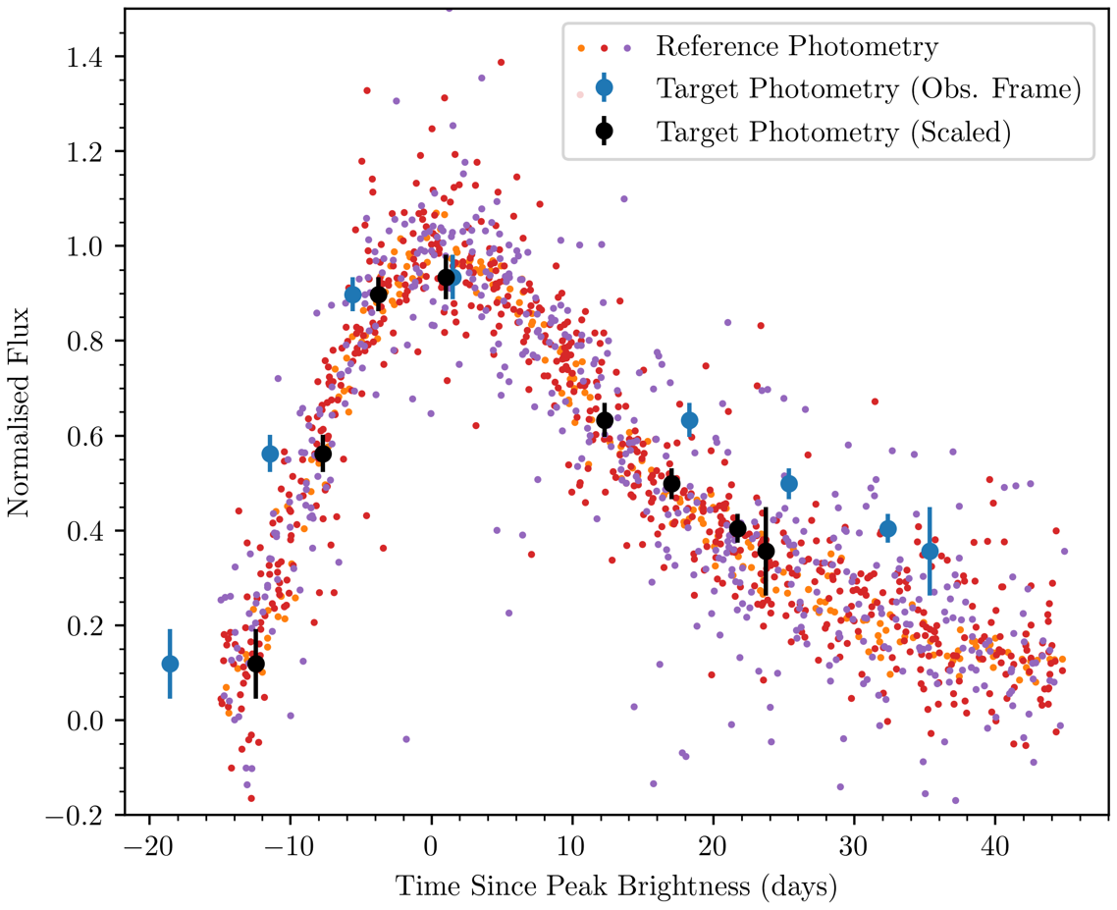
With all of our reference curves made, we can find the ‘width’ of each individual light curve

Slide 12
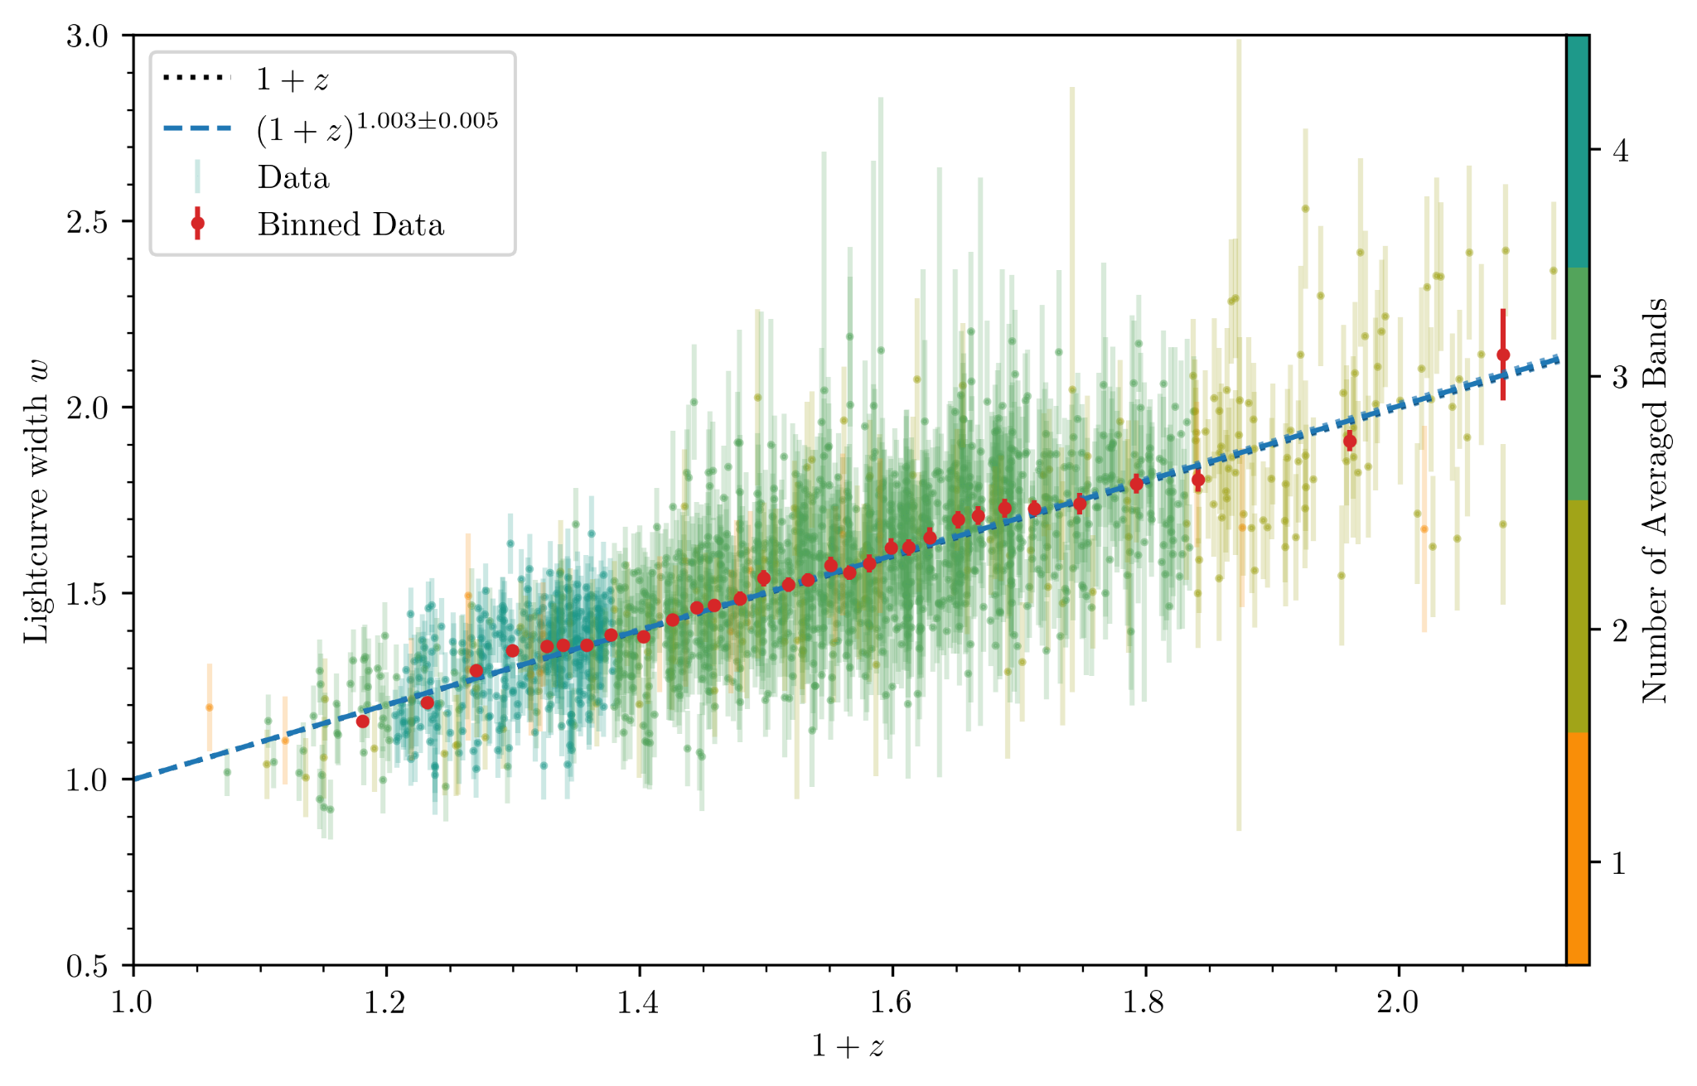
And when we do this for all individual light curves we quantify time dilation!

Slide 13
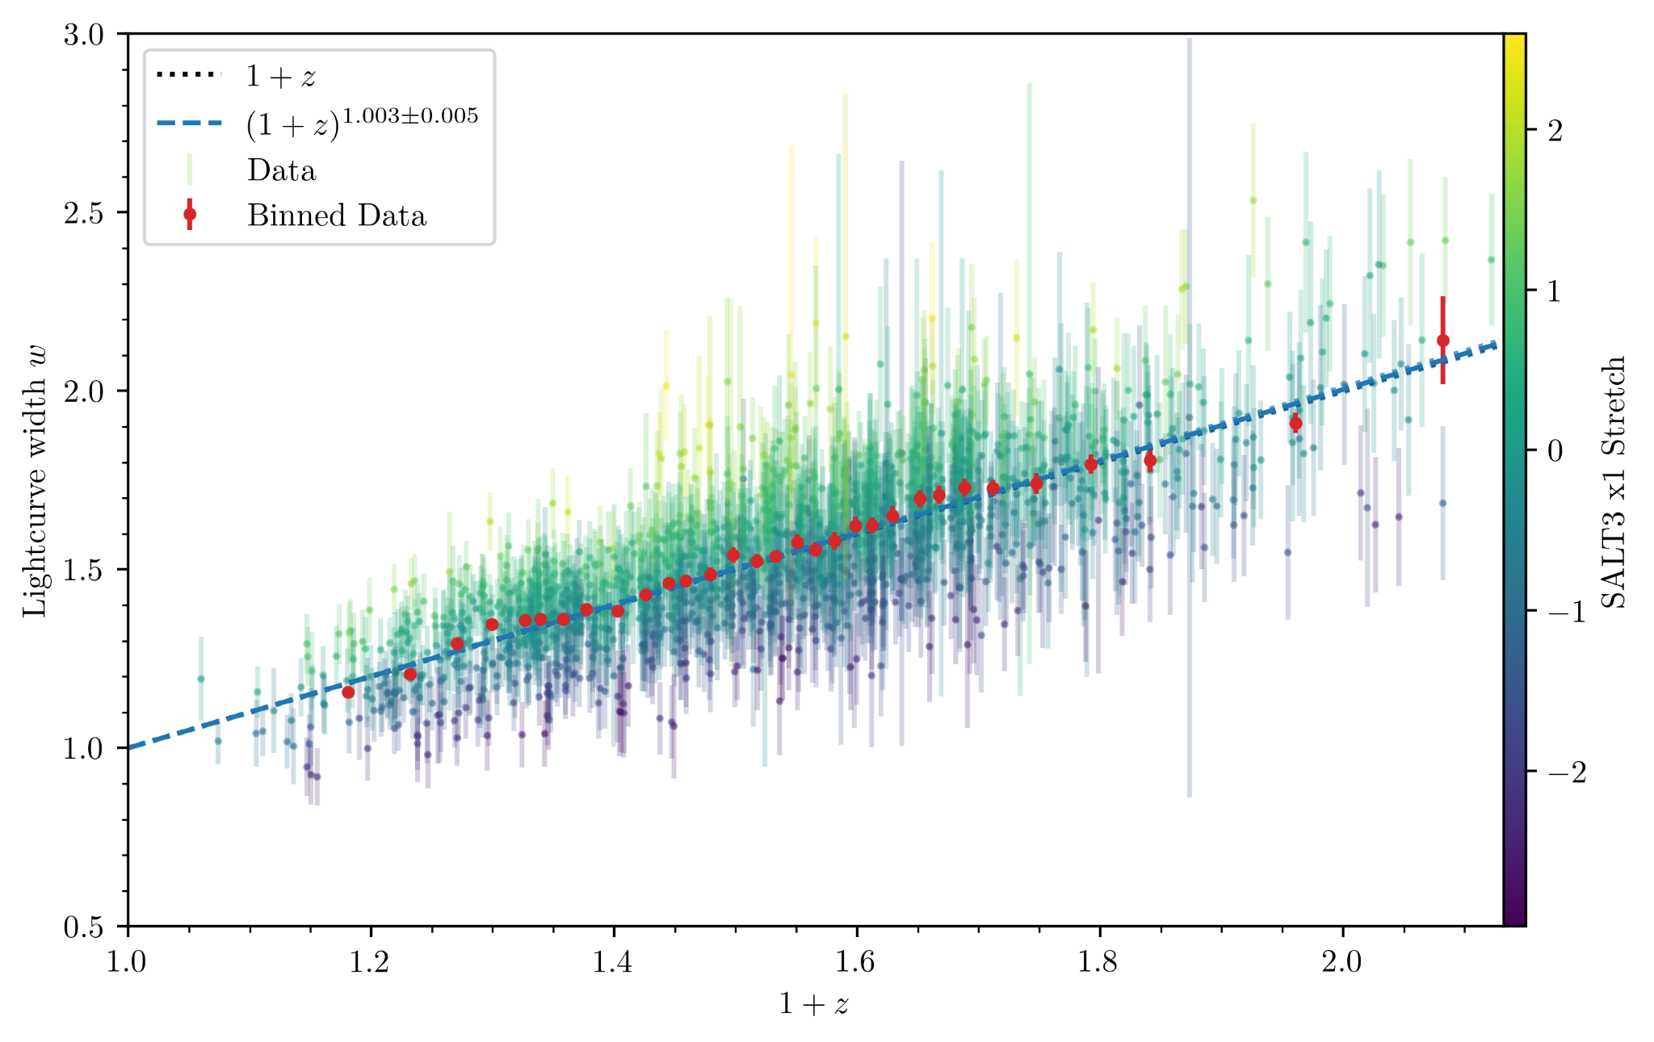
There is scatter in the widths not just from noise, but also from intrinsic variation

Slide 14
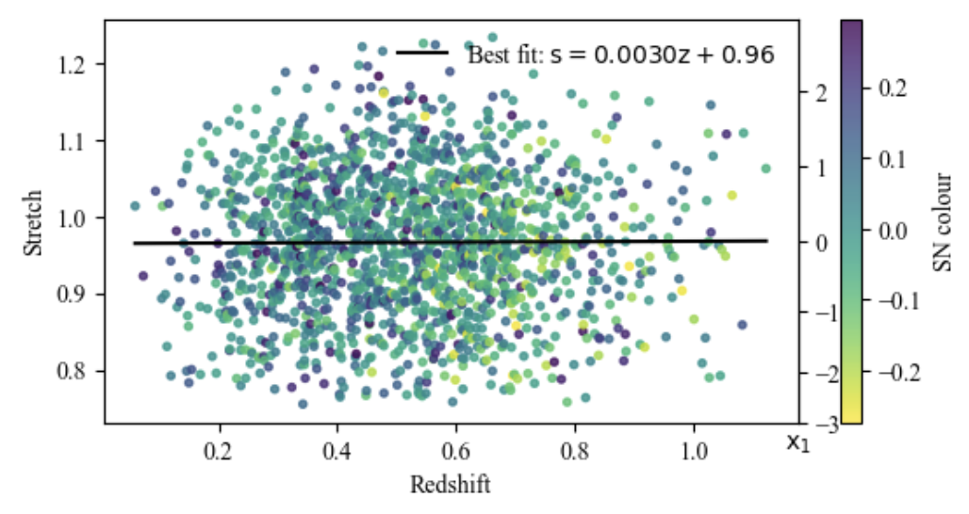
There is scatter in the widths not just from noise, but also from intrinsic variation

Slide 15
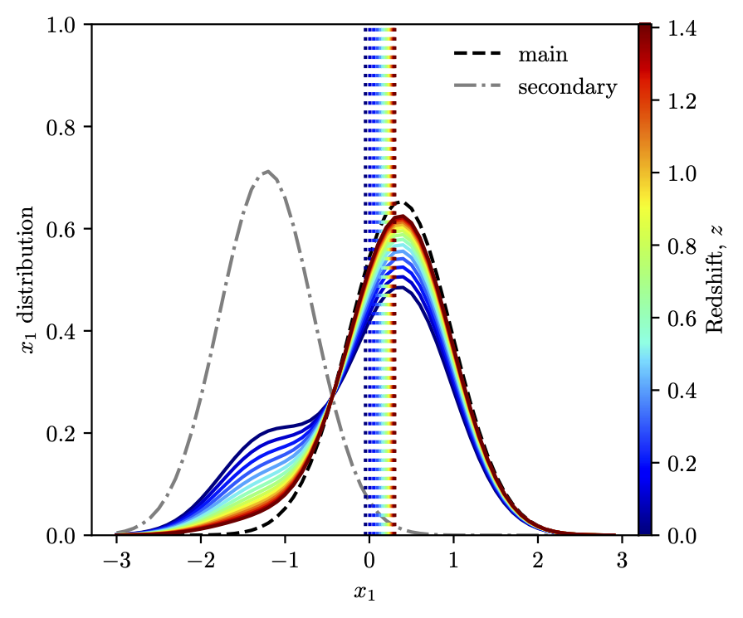
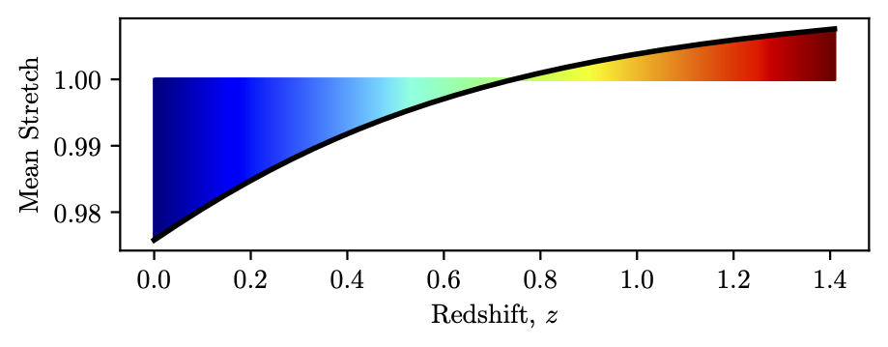
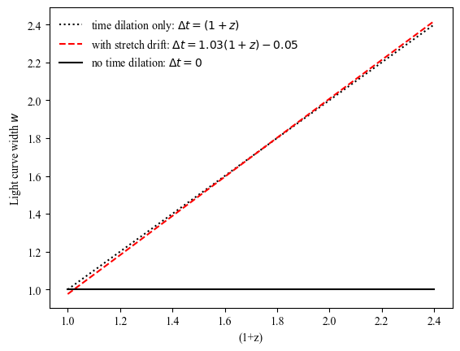
Some people have seen some stretch drift in the population vs redshift
Model from Nicholas et al. 2021
We don’t see stretch drift but even if it was there it is only a couple of %, not a factor of 2.

